Slide 1


Online
VISHWA VIDYAPEETHAM
21CSA697A – Minor
DATE:08/02/2026

Slide 2

Online
• PASSWORD STRENGTH CLASSIFICATION
• KETHA DEVIKA
• AA.SC.P2MCA24074048
• MCA AI
• Semester - 3
• AMRITA VISHWA VIDYAPEETHAM

Slide 3
Introduction
• Domain overview:Password strength classification falls within the domain of cybersecurity and information security, focusing specifically on authentication mechanisms and user credential protection. The domain addresses the challenge of evaluating how secure a password is against various types of cyberattacks, dictionary attacks, and social engineering–based guessing techniques.
• Research context and motivation: Traditional password strength checkers rely on rule-based approaches, such as minimum length, inclusion of special characters, or predefined blacklists. In this context, password strength classification using machine learning has gained research interest. The motivation for this research is to develop a robust password strength classification system that improves security without compromising usability.
• Practical and academic relevance: Password strength classification plays a critical role in enhancing real-world cybersecurity. Weak passwords are a primary cause of data breaches, identity theft, and unauthorized system access. In academia, password strength classification is a significant research area within cybersecurity and applied machine learning. It provides a practical problem domain for evaluating classification algorithms, feature engineering techniques, and performance metrics such as accuracy, precision, recall, and F1-score.

Slide 4
Problem Statement
• Clearly defined research / technical problem: The research problem addressed in this work is the accurate classification of password strength using data-driven techniques. Specifically, the challenge is to develop a password strength classification model that can reliably categorize passwords into predefined strength levels (such as weak, medium, and strong) by learning complex patterns from password data, rather than relying on static, rule-based heuristics.
• Limitations in current systems:
Lack of Scalability and Personalization: Many systems apply uniform strength criteria to all users and applications, ignoring varying security requirements and user contexts. This limits their applicability across diverse platforms.
Research gap being addressed:A key research gap lies in the absence of adaptive and data-driven classification models that can effectively learn complex structural, sequential, and contextual features of passwords while maintaining high accuracy and usability. Existing research often focuses solely on improving classification accuracy, with limited attention to issues such as class imbalance, interpretability of model decisions, robustness against evolving attack strategies, and integration feasibility in real-time authentication systems.

Slide 5
Objectives
1.Improve Password Entropy: Increase average password entropy score by 20% within the next 6 months. Achieve an average entropy score of 60 bits or higher for all user passwords.
2. Reduce Weak Passwords: Decrease the percentage of weak passwords (entropy < 30 bits) to less than 5% within 3 months. Identify and prompt users to change 90% of weak passwords within 1 week of detection.
3. Enhance Password Complexity: Ensure 80% of passwords meet complexity requirements (uppercase, lowercase, digits, special chars) within 6 months. Increase the percentage of passwords with 12+ characters to 70% within the next quarter.
Align objectives with the problem statement
1.Enhance Password Security
2.Reduce Weak Passwords
3.Improve Password Complexity and Uniqueness

Slide 6
Scope of the Project
• Project boundaries:The project is confined to evaluating password strength through classification into predefined categories such as weak, medium, and strong.
• Constraints and assumptions:
Constraints:The performance of the password strength classification model is dependent on the quality, size, and diversity of the available password dataset.
Assumptions:The datasets used for training and testing reasonably represent common real-world password patterns.
• Applicability domain:The password strength classification system developed in this project is applicable to digital platforms that rely on password-based authentication mechanisms. The model is suitable for environments where improving password quality is

Slide 7
Literature Review/Existing System
Password Strength Analysis and its Classification by Applying Machine Learning Based Techniques: This paper explores using machine learning models like decision trees, random forests, and AdaBoost to classify passwords into strength categories. The decision tree, random forest, and AdaBoost models achieved a robust accuracy rate of 84% ¹.
Empirical Study of Password Strength Meter Design: This study discusses various password strength meters and their effectiveness. It highlights the importance of entropy calculation and proposes a reduction mechanism to improve password scoring.Password Strength Analysis and its Classification by Applying Machine Learning Based Techniques: This paper explores using machine learning models like decision trees, random forests, and AdaBoost to classify passwords into strength categories. The decision tree, random forest, and AdaBoost models achieved a robust accuracy rate of 84% ¹.
Machine-Learning-Based Password-Strength-Estimation Approach for Passwords of Lithuanian Context: This research focuses on adapting password strength estimation to non-English environments, specifically Lithuanian passwords. It achieves 77% accuracy using a decision tree algorithm with Levenshtein Ratio similarity measure..
Strength Analysis of Real-Life Passwords Using Markov Models: This paper analyzes password strength using Markov models and compares their performance with other techniques like PCFG-based models. The study finds Markov models effective in distinguishing between strong, medium, and weak passwords ².

Slide 8
Proposed System
• Research Methodology / Proposed Approach
• Overall workflow
• Justification of approach:The proposed data-driven approach for password strength classification is justified by the limitations of traditional rule-based password evaluation systems. Rule-based methods rely on fixed heuristics that fail to capture complex and evolving password patterns, often leading to inaccurate strength assessments and poor user experience.
• Novelty/ innovation:The novelty of the proposed password strength classification system lies in its shift from static, rule-based evaluation to a fully data-driven and adaptive learning approach. Unlike traditional systems that depend on fixed password rules, the proposed model learns complex structural and sequential patterns directly from password data, enabling more accurate and realistic strength assessment

Slide 9
Architecture
Architecture diagram
Password Input
↓
Data Preprocessing
↓
Feature Extraction
↓
Classification Model
↓
Strength Output
(Weak / Medium / Strong
Module interaction:
Password Input Module: The system receives the user-entered password during registration or password creation. This module acts as the entry point for the data flow.
Data Flow :
Password Input → Preprocessing → Feature Extraction → Classification → Strength Output & Feedback

Slide 10
Methodology/Algorithms
Step-by-step workflow
Algorithms or models used
Logistic Regression: Used as a baseline classification model due to its simplicity, fast computation, and interpretability.
Naïve Bayes Classifier: A probabilistic model effective for text-like password features and suitable for low-complexity systems.
Justification for selection:The algorithms selected for password strength classification are chosen to balance accuracy, efficiency, and practicality. Baseline machine learning models such as Logistic Regression and Naïve Bayes provide simplicity and interpretability, while ensemble methods like Random Forest improve robustness and handle complex patterns.

Slide 11
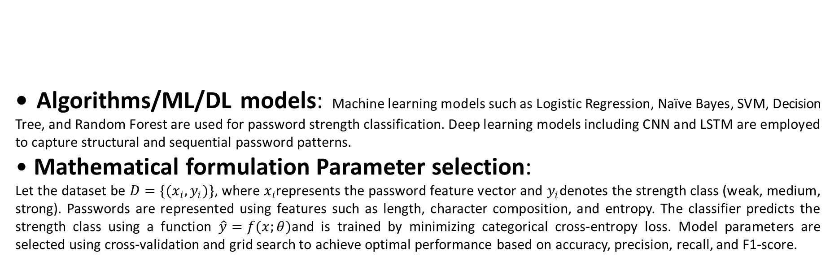
Implementation Details

Slide 12
Dataset Description
• Source of data
Preprocessing steps:
Removal of duplicate passwords
Cleaning and correction of labels
Normalization of password format
Feature extraction (length, character composition, entropy)
•Train-test split/validation strategy: The dataset is divided into training and testing sets using a standard split (e.g., 80% for training and 20% for testing). Cross-validation is applied on the training set to ensure robustness, reduce overfitting, and improve generalization performance.

Slide 13
Implementation Details

Slide 14
Implementation Details
zxcvbn – an open‑source password strength estimator (JavaScript/Python).2.Passlib – Python library for password hashing & strength checking.3. OWASP JavaScript Password Strength Meter – web‑based strength meter.4. Jasypt – Java library for password encryption & strength analysis.5. Django password validators – built‑in Django framework validators for strength checks.6. NIST guidelines – framework for password policy & strength recommendations (used in design).
•Module-wise implementation
•Version control (GitHub) usage

Slide 15
Results & Output
• Quantitative results (tables, graphs):
Accuracy Comparison Bar Graph: A bar chart comparing accuracy of different ML and DL models shows that Random Forest and LSTM outperform traditional classifiers.
• Comparative analysis with existing methods: Traditional rule-based methods rely on fixed rules and often misclassify passwords. Basic machine learning models improve accuracy but have limited adaptability.
• Interpretation of results: The experimental results show that data-driven models provide more accurate password strength classification than traditional rule-based methods.

Slide 16
Testing & Validation
• Test cases / validation strategy
• Error analysis: Error analysis reveals that most misclassifications occur between adjacent classes, particularly between medium and strong passwords, due to overlapping characteristics.
• Robustness checks: Robustness of the password strength classification system is evaluated by testing the model on unseen and diverse password samples. Performance consistency is verified using cross-validation and by varying train–test splits.

Slide 17
Conclusion and Future enhancements
• Summary of work done:
This project focused on developing a data-driven password strength classification system. Publicly available password datasets were collected and preprocessed, and features such as length, character composition, and entropy wereextracted.
• Achievement of objectives:
Existing limitations of rule-based password evaluation were addressed by implementing data-driven models.
Feature extraction and model training were completed successfully, providing accurate strength classification.
Performance evaluation demonstrated high accuracy, precision, recall, and F1-score, confirming the effectiveness of the approach.

Slide 18
References
• Papers, books, websites
• Use standard citation format

Slide 19
THANKYOU
onlineamrita.com

